Slide 1
Capstone Project

Slide 2
1. Introduction
New York has always been the vibrant city. It is often selected as the best city for college students who seek professional success, as New York is full of job opportunities. Therefore, through completing this capstone project, I would like to find the best place to live in New York for college students. Specifically, I will start with the area (Manhattan, Brooklyn) nearby New York University that has 50,000+ students. It starts with the assumption that college students like places nearby sports facilities such as gyms and yoga studios.

Slide 3
2. Data to use
I will use the "newyork_data.json" data that we used for the practice in the earlier module and Forsquare data to find clusters of sports facilities in New York. This will give the recommendation of places to live for young people moving in New York.

Slide 4
3. Methodology
I will mainly use K means clustering to recommend five different clusters of sports facilities nearby New York University. As a result, I will help NYU students moving into town to settle down easily where they prefer.

Slide 5
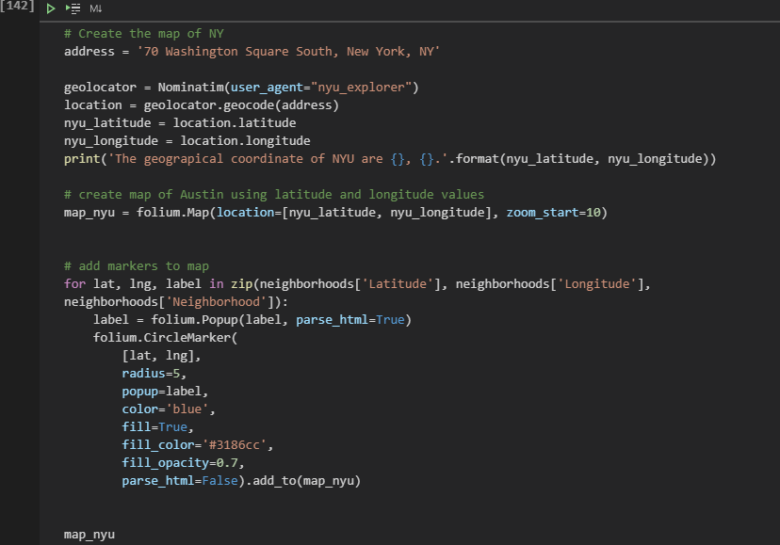
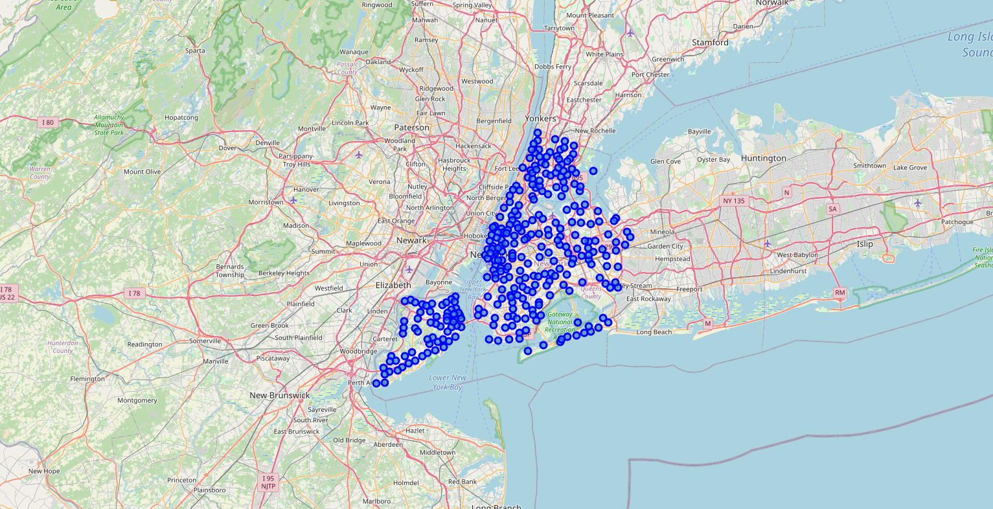
Example 1

Slide 6
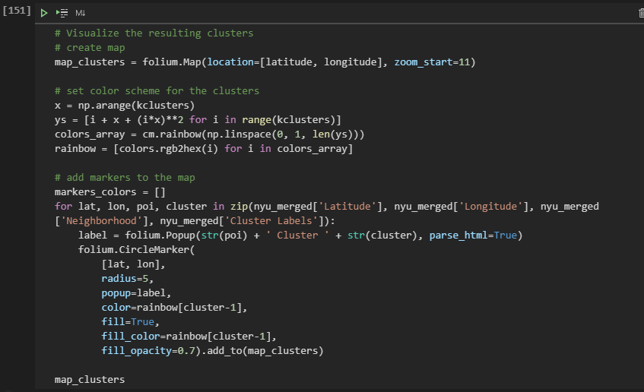
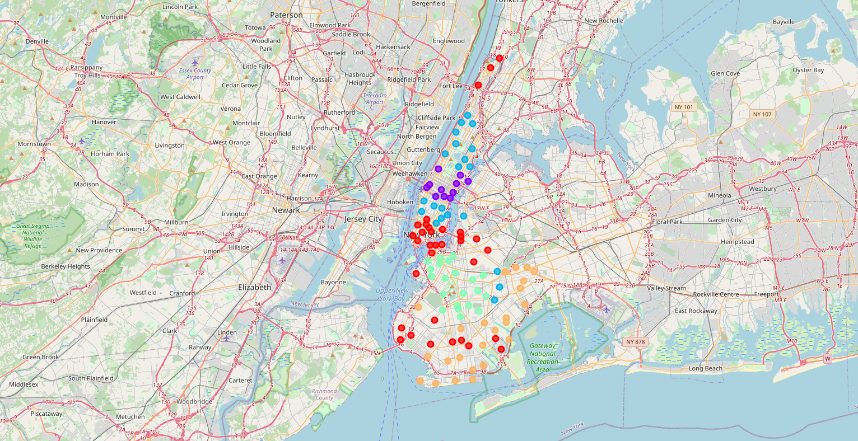
Example 2

Slide 7
4. Results
Most common sports facilities in cluster1 neighborhoods are Yoga Studios and Gym / Fitness Center
Most common sports facilities in cluster2 neighborhoods are Gyms
Most common sports facilities in cluster3 neighborhoods are Yoga Studios and Gyms
Most common sports facilities in cluster4 neighborhoods are Fields and Climbing Gyms
Most common sports facilities in cluster5 neighborhoods are Gyms and Gyms / Fitness Centers

Slide 8
5. Discussion
Even though there are some variations in different clusters, it is notable that gyms, fitness centers, and yoga studios are the most common sports facilities that college students can find in New York City, especially nearby New York University buildings. It well reflects the trend of sports facilities college students prefer: weight training, yoga, and cardio workout.

Slide 9
6. Conclusion
This capstone project proves that the location of sports facilities reflects the needs of residents. As young people spend most of their time around New York University, the area around it is filled with sports facilities they like.

